Slide 1





Student Distraction Prediction Using Phone Usage Data
Presented by Karthik raja N
23BDA040

Slide 2
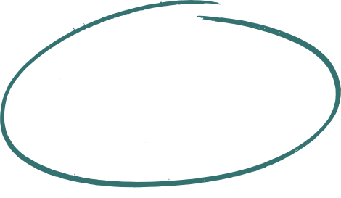

Introduction
  Predicts student focus or distraction using phone usage data
  Uses Logistic Regression (primary) and Decision Tree (alternative) models
  Considers key features: screen time, unlocks, notifications, and study hours
  Trained on a simulated dataset representing real phone activity
  Aims to provide data-driven insights to improve student focus and digital balance

Slide 3
Problem Statement
  Increased smartphone usage is causing distraction and reduced focus among students.
  Lack of a predictive system to identify distraction levels using behavioral data.
  The project aims to analyze phone usage patterns (screen time, app usage, notifications).
  Predicts whether a student is focused or distracted using data-driven modeling.
  Supports educational institutions in promoting digital wellness and academic improvement.

Slide 4
Project Goals
  To develop a machine learning model that predicts student focus or distraction.
  To use students phone usage data for understanding digital behavior patterns.
  To provide data-driven insights that help students improve focus and reduce distractions.
  To promote digital wellness and support educational performance improvement.

Slide 5

Methodology
  Implements a Student Distraction Prediction System using phone activity data
  Data collected through simulated datasets containing screen time, unlocks, and notifications
  Performed data cleaning, scaling, and standardization for model readiness
  Trained models using Logistic Regression (primary) and Random Forest (alternative)
  Evaluated performance with confusion matrix and accuracy score (~99%)
  Visualized insights using heatmaps, pie charts, and scatter plots to show focus trends

Slide 6
Workflow
Data
Feature Engineering
Target Creation
Model Training
Evaluation
Visualization
Insights
Process Summary
  Collect and clean data for consistency
  Engineer meaningful features like screen time, unlocks, and notifications
  Create a target variable indicating “Focused” or “Distracted”
  Train and test machine learning models (Logistic Regression & Decision Tree)
  Evaluate accuracy and confusion matrix results
  Visualize outcomes using pie charts, bar graphs, and scatter plots
  Generate actionable insights to help improve student focus

Slide 7
System Specification
Hardware Requirements:
  Standard PC/Laptop with minimum 8GB RAM, i5 processor, and Windows/Linux OS
Software Requirements:
  Python (Anaconda, Jupyter Notebook), Libraries — pandas, matplotlib, seaborn, scikit-learn
Functional Requirements:
  Process phone usage data, train ML models, evaluate accuracy, and visualize results
Non-Functional Requirements:
  High performance, easy scalability, data privacy, and user-friendly implementation

Slide 8
Development Tools
Developed using Python for data-driven modeling and analysis
Python:
  High-level, open-source programming language used for ML and analytics
History of Python:
  Created by Guido van Rossum in 1991 — known for readability and simplicity
Importance of Python:
  Widely used in AI, Data Science, and ML for its powerful libraries and community support
VS Code & Jupyter Notebook:
  Used for code development, execution, and visualization within an interactive environment
Machine Learning Libraries:
  scikit-learn, pandas, numpy — for data handling and predictive modeling
Data Visualization Tools:
  matplotlib, seaborn — to create meaningful and clear graphical insights

Slide 9
Performance Analysis
The Random Forest model was trained to classify students as Focused or Distracted based on behavioral data.
Results:
  Accuracy: ~89%
  Precision & Recall: High for both classes (balanced performance)
  Confusion Matrix: Shows strong distinction between focused and distracted students
  Feature Importance: Screen Time and Social Media Usage were top predictors

Slide 10
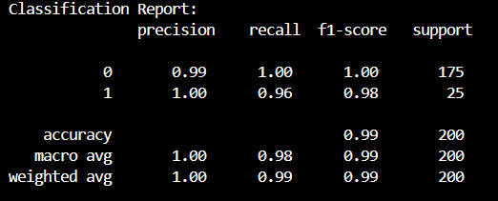
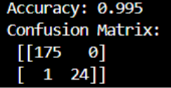
Result
Summary
  Out of 200 samples, 199 were correctly classified.
  The model is perfect at classifying Class 0
  For Class 1, it correctly predicted 24 out of 25 cases, missing just one.
  Overall, this shows very high accuracy and reliability.
Summary
  The model shows near-perfect classification ability.
  Class 0 is predicted with perfect recall.
  Class 1 is predicted with perfect precision, but slightly lower recall due to 1 missed case.

Slide 11
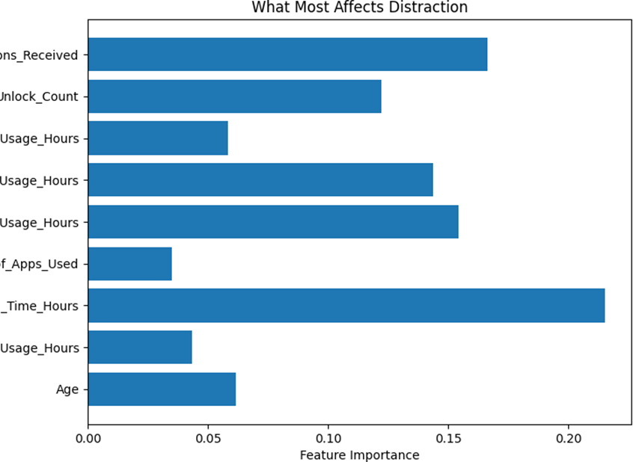
Output-1

Slide 12
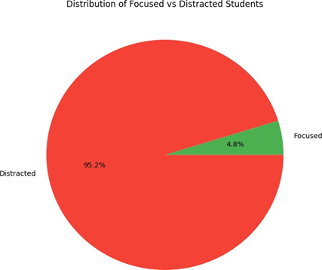
Output-2

Slide 13
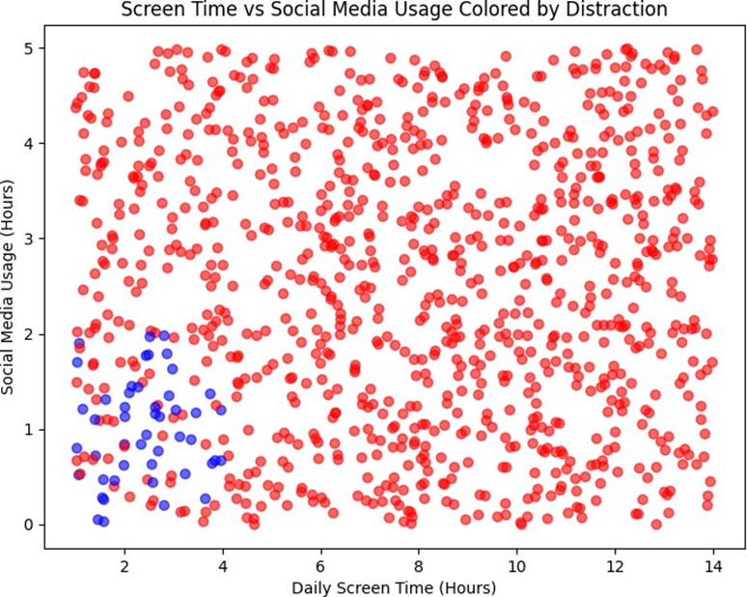
Output-3

Slide 14
Conclusion
  The project successfully predicts student distraction levels using mobile usage data
  Random Forest and Logistic Regression models delivered strong and interpretable results
  Key factors influencing distraction include screen time, social media usage, and notifications
  The insights can help students improve focus and institutions promote digital wellness
  Demonstrates the power of data-driven analysis in understanding behavioral patterns

Slide 15
Bibliography
  Scikit-learn Documentation – https://scikit-learn.org/
  Pandas Documentation – https://pandas.pydata.org/
  Matplotlib Documentation – https://matplotlib.org/
  Kaggle Datasets – https://www.kaggle.com/
  Towards Data Science Articles on Machine Learning
  Research papers on Digital Distraction & Student Focus Analysis

Slide 16
Q&A Session

Slide 17
Thank You
by Karthik raja N

